Slide 1

CSCI 586 Final Project - Ontology Integration
Books and Movies
Team member: Li Qiu, Weiwei Zheng, Chien-Hsing Lu

Slide 2

Books & Movies
Why we choose it?

Slide 3
Our goals
Build Ontology and model data from heterogeneous data source
Present our result on webpage with intuitive UI

Slide 4
Steps
Collecting data
Creating Ontology & Data Modeling
Back-end & UI design

Slide 5
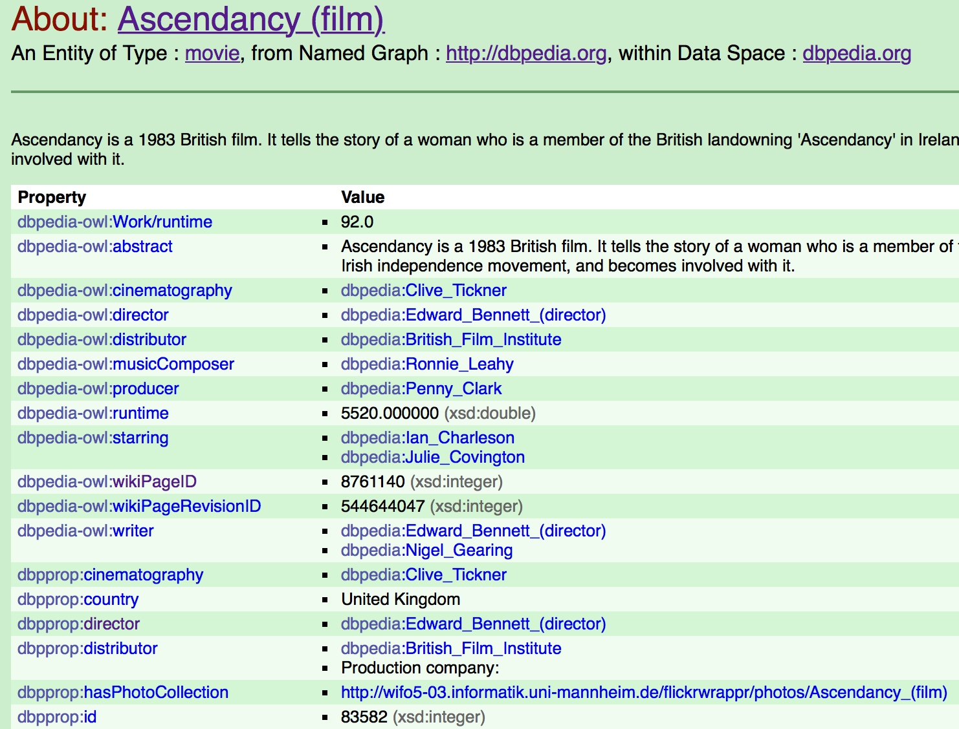
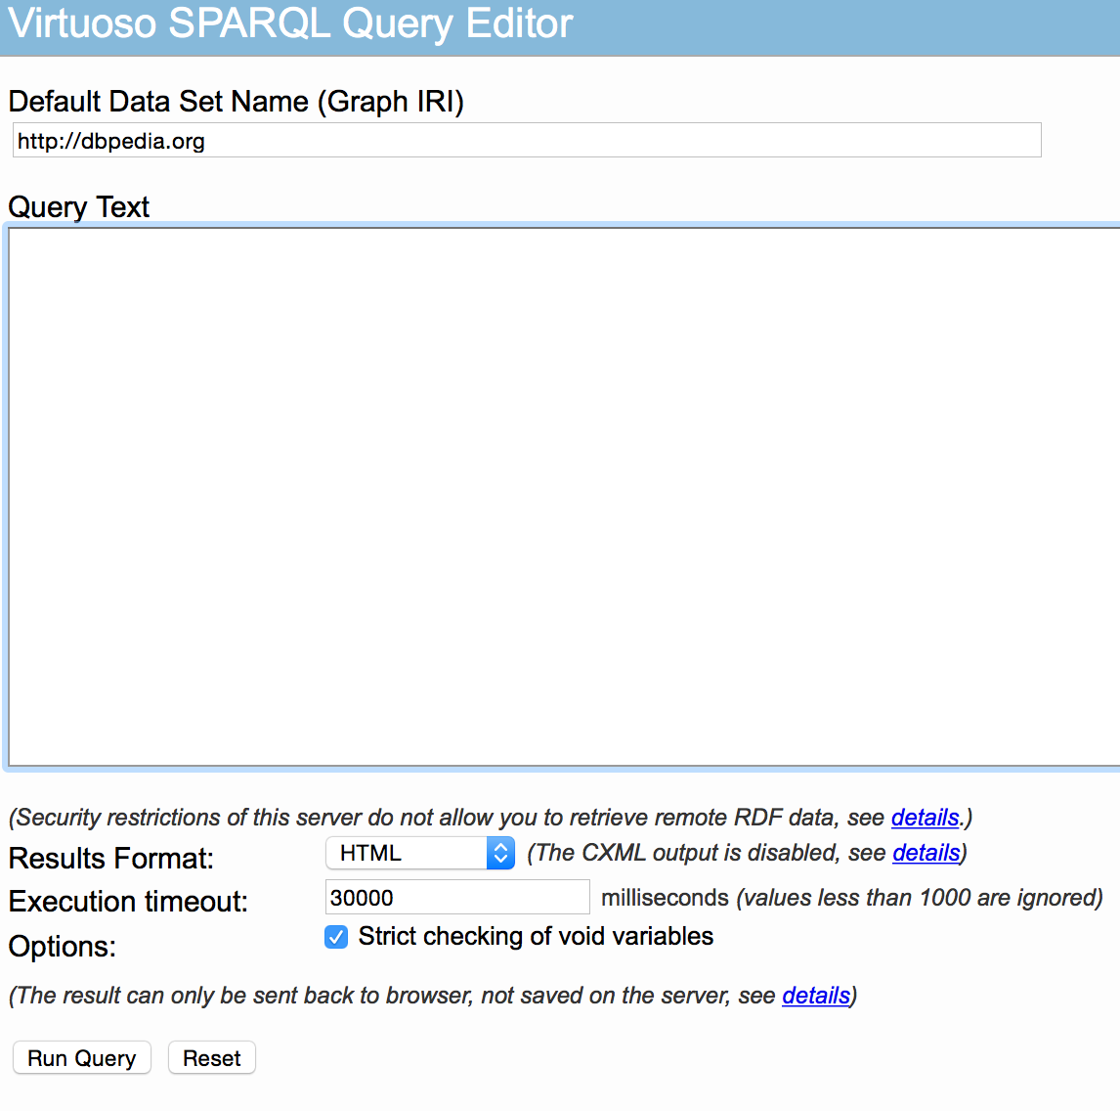
Collecting Data
DBPedia
SPARQL

Slide 6
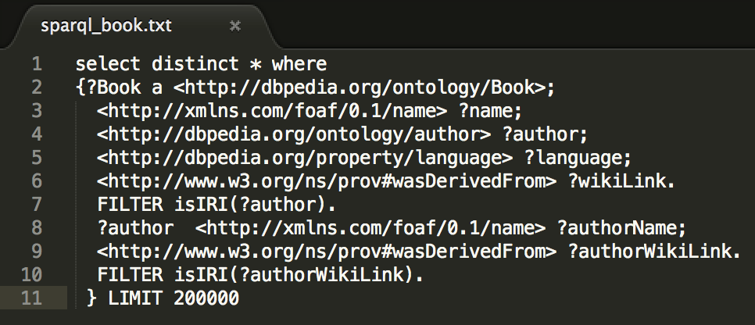
Collecting Data
Script For Book

Slide 7
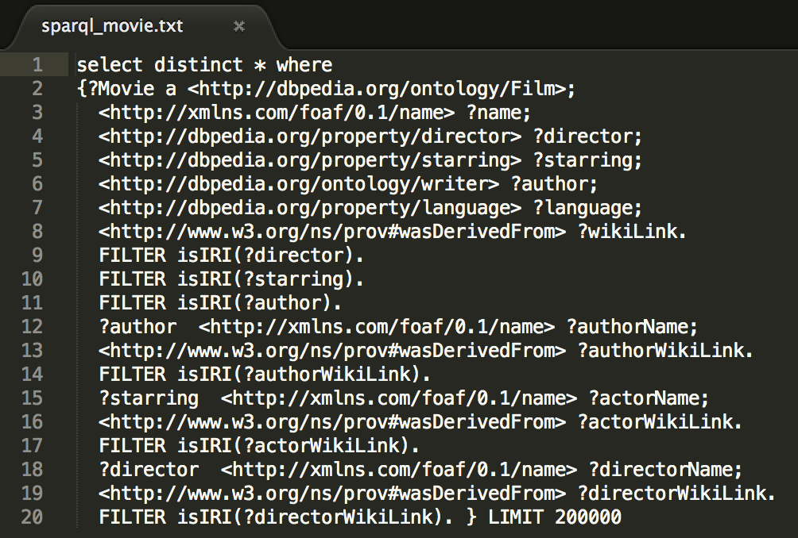
Collecting Data
Script For Movie

Slide 8
Creating Ontology
Decide and build class hierarchy
Build object properties
Build data properties

Slide 9


Data Modeling
Thing
genre
Genre
Book
Movie
starring
author
Person
director
Actor
Author
Director

Slide 10
Data Modeling
Thing
abstract
Movie
name
Person
wikiLink
language
name
country
Book
name
release
language

Slide 11
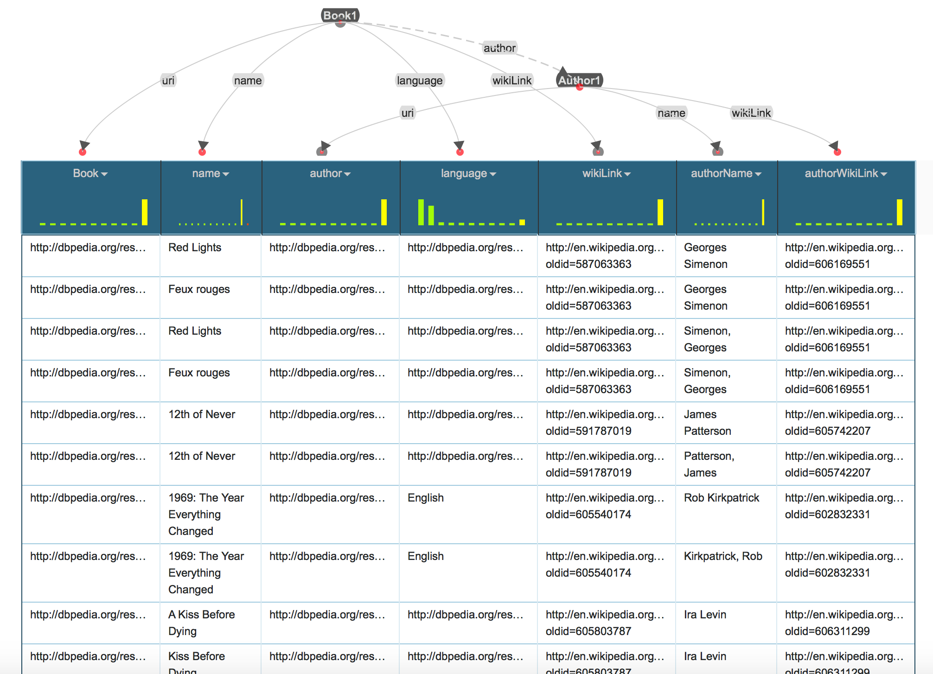
Data Modeling

Slide 12
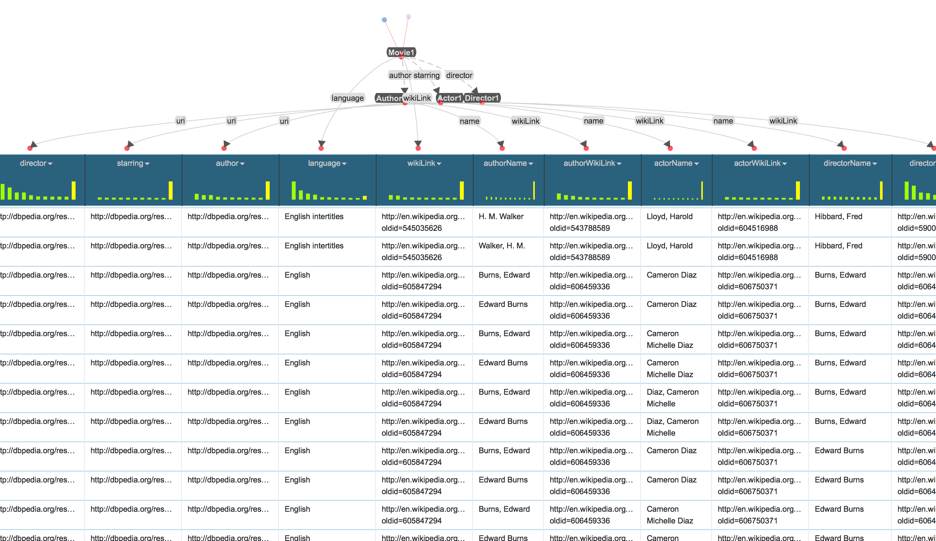
Data Modeling

Slide 13

Back-end
Apache Tomcat
Java Servlet

Slide 14

UI Design

